Slide 1
Week 1:
Field Carrier Landing Pattern (FCLP)

Slide 2
Field Carrier Landing Pattern (FCLP)
FCLP is conducted to help student naval aviators become familiar with the procedures of landing on a boat. The ability to successfully complete FCLP increases the likelihood that a student will be successful in their carrier qualification attempts.
The basic pattern for FCLP is the same as a Case I carrier recovery. Each aircraft will have specific nuances such as initial speed, break speed, and configuration speeds, but the basic pattern remains the same.

Slide 3
FCLP Standards
Pilots and NFOs will complete 5 FCLPs with one of those FCLPs to a full stop landing.
Pilots will fly the FCLP pattern on their own minding pattern altitude, heading, configuration speeds, and getting the aircraft “On Speed.” The pilot will be responsible for all ATC communications.
NFOs will describe the pattern for the pilot to execute. The NFO will monitor altitude, heading, configuration speeds, and “On speed” indications. The NFO will admonish the pilot on any corrections that need to be made, making speed and configuration calls, and assisting the pilot remain on speed. The NFO will be responsible for all ATC communications.

Slide 4
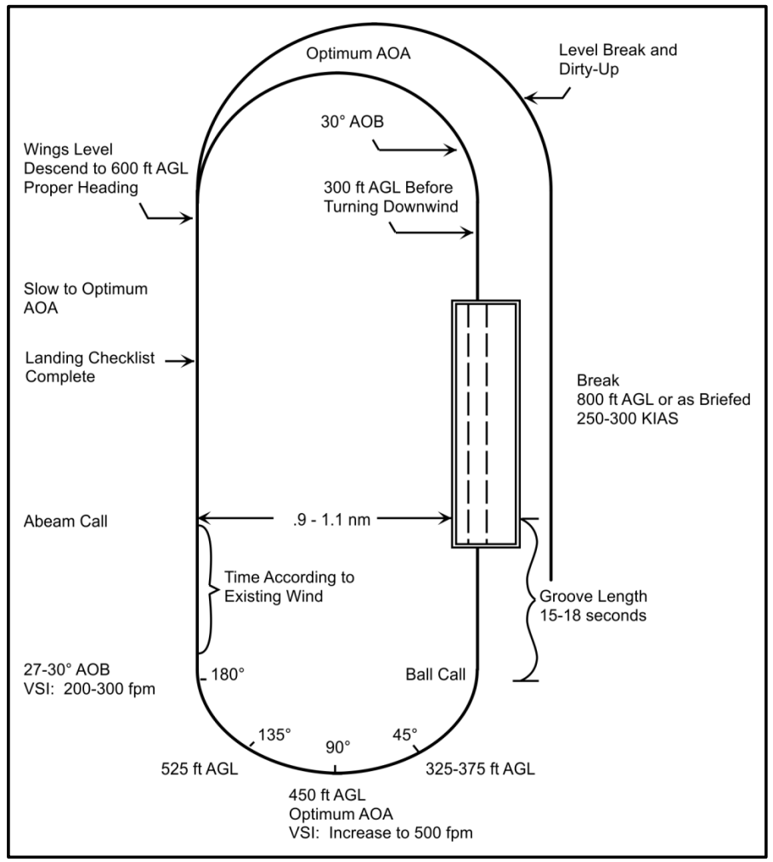
FCLP Pattern

Slide 5
FCLP Pattern Entry.
The FCLP pattern is a racetrack pattern.
Call ATC when on the the initial 3 miles from the airfield when at 800’ AGL and 300 knots.
The tower may direct you to switch to the "paddles" frequency prior to the break or once established on downwind.
ATC Communications example:
Student: Navy [Modex], Initial.

Slide 6
Break
Execute a level 17-unit break at 70-80 degrees angle of bank, 300 KIAS at 800 ft AGL. Reduce power to idle and extend speed brakes. Lower your landing gear and flaps/slats below 200 KIAS.
When beginning the break, the student will announce: “In the break.”
The student pilot will monitor airspeed, altitude, and angle of bank. The student pilot configure the aircraft at the appropriate airspeed.
The student NFO will monitor airspeed, when configuration speed is reached, the student announce will tell the pilot: “200. Gear Down. Flaps Down.”

Slide 7
Downwind
Descend to 600 ft AGL when wings level on downwind, trim for on speed, cross-check AOA, and complete the landing checklist prior to reaching the abeam position. Maintain the proper interval and fly to an abeam distance of 0.9 to 1.1 nm laterally at an altitude of 600 ft AGL. Fly the reciprocal of the runway heading. Prior to reaching the 180, your aircraft should be trimmed up for optimum AOA in level flight.
The landing checklist for a single pilot will be verbalized. For the NFO it will be read in a challenge-response fashion
Example: NFO - Landing Gear; Pilot - Down.

Slide 8
Abeam
Abeam is the position directly lateral of the end of the runway (representing the aircraft carrier’s “round down”).
Make a full abeam call to the LSO. stating your side number, abeam, and fuel state. Do not transmit when another aircraft is on the ball unless it is an emergency.
Student: “[Modex] abeam, state [fuel leave in Thousands.Hundreds (e.g. 4,600 pounds would be State 4.6)

Slide 9
180 Degree Position
The proper 180 position is 15 seconds past the abeam. At the 180 position, roll into 27-30 degrees AOB and adjust power to set a 200-300 fpm rate of descent. Maintain optimum AOA. Being too wide abeam at the 180 will require less AOB to arrive at the correct 90-degree position, while being too close abeam will require up to maximum AOB to prevent an overshoot.
The turn from the 180 to the 90 should primarily be an instrument scan.

Slide 10
90 Degree Position
At the 90 (450 ft AGL), maintain optimum AOA and increase rate of descent to 500 fpm. It may be necessary to adjust altitude if you are too deep or too close. If you are too deep at the 90, 450 ft AGL will result in a low start. If you are too close, 450 ft AGL will result in a high start. Passing through the 90, adjust AOB as necessary to prevent overshooting or undershooting the centerline.
At the 90, transition from an instrument scan to an inside/outside scan.

Slide 11
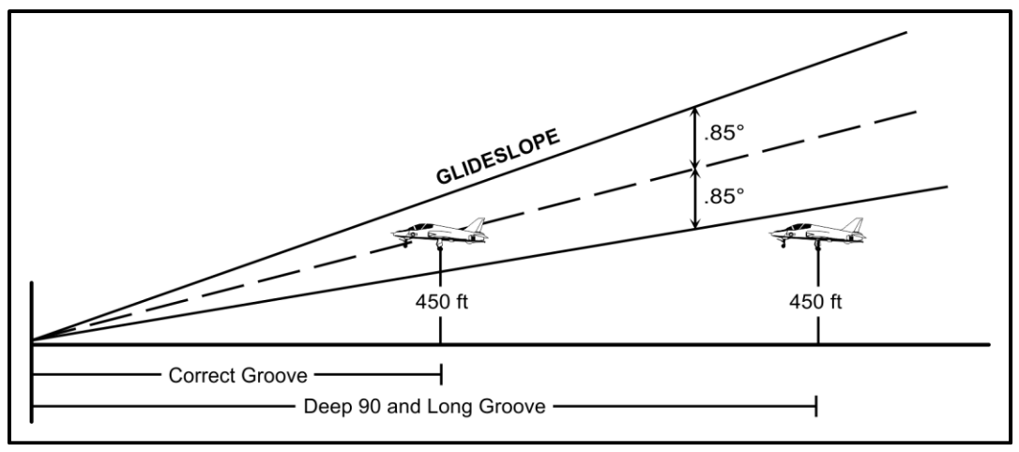
Deep 90

Slide 12
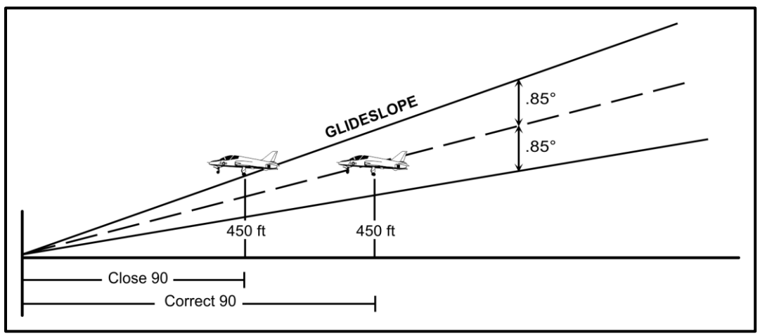
Close 90

Slide 13
45 Degree Position
Pass through the 45 at 325-375 ft AGL at optimum AOA. At this position, you should acquire the ball. From the 45 to the start, adjust AOB to arrive on centerline, maintain on-speed attitude and rate of descent to arrive with a stabilized centered ball. An aggressive VSI scan from the 45 to the start position will allow for a stabilized rate of descent and is paramount.
The ball position at the 45 is mainly a reference and corrections should be made on the VSI. Because of the width of the glideslope, flying the ball at the 45 will normally result in over corrections.
Note: DCS does not support a land-based IFOLS system, so ball references are just for general knowledge in the FCLP.

Slide 14
Start
The start is, without a doubt, the most important phase during FCLPs, carrier qualifications, and carrier-type approaches. Pilots need to arrive wings level, on centerline, on speed with proper rate of descent (ROD) to maintain a centered ball. Poor starts are a direct result of improper abeam/180 positions, RODs that do not allow for proper 90 and 45 altitudes, and not flying an optimum AOA. If the meatball is not acquired by the start, a "Clara" shall be made.

Slide 15
Groove
The groove is the portion of the approach from a wings-level start to touchdown; ideally this should be 15-18 seconds. With the ball in sight, call the ball. Do not call the ball if the aircraft ahead of you is on the ball or just touching down. Never descend below 300 ft AGL without a ball. Ball Call Example: [Aircraft Type], Ball, State [Fuel State]. In an aircraft with an NFO, the NFO will make the ball call.
The glideslope is a 3.25 degree fixed path. Your goal is to keep the meatball centered/cresting, stay on centerline and on speed all the way to touchdown.
If the ball is low, fix it early by getting the ball back above the datums. Don’t wait until in-close to at-the-ramp to fix a low ball. If the ball is high in close, do not attempt to re-center the ball but stabilize it while remaining on speed. Correct for glideslope, lineup, and AOA with quick, aggressive coordination of stick and throttle. Make a correction as soon as one is required.

Slide 16
Touchdown
Touchdown should occur on centerline, on speed, with a centered ball. Upon touchdown, simultaneously advance power to military power, and retract speed brakes.
Prepare to rotate to takeoff attitude. Maintain wings level and verify a positive rate of climb. Turn downwind off your interval (at 300 ft AGL or higher) if required.

Slide 17
Waveoff
The waveoff is a mandatory signal and comes in verbal form from the LSO, or in the form of red flashing lights on the lens, or both. To perform a waveoff, simultaneously advance the power to military, retract the speed brakes, and maintain optimum AOA. Level the wings if necessary and verify a positive rate of climb.
When you have established a comfortable climb and are approaching pattern altitude (600 ft AGL), adjust power as necessary to maintain altitude and pattern airspeed.

Slide 18
Turn to Downwind
After a waveoff, bolter, or touch and go, begin the turn to downwind after climbing to a minimum of 300 ft AGL and when your interval is at your 10 o'clock position. During your climb and turn downwind, maintain 130 KIAS or on-speed AOA, whichever is greater, and 30-degree AOB in the crosswind.

